Slide 1
Handoff from Monetary to Fiscal:
Economic and Financial Market Outlook for 2017
Presented to:
MGFOA Annual Spring 2017 Meeting
Presented by:
John Sherman, CFA
Senior Portfolio Manager
Federated MDT Balanced Fund
May 2017
Federated Securities Corp. Distributor 17-69929 (5/17)
  INSTITUTIONAL Sales Material. Not for Distribution to the Public.
.

Slide 2
Economic and Financial Market Outlook:
“If you spend more than 13 minutes reviewing economic and market forecasts, you’ve wasted 10 minutes.”
-Peter Lynch
2

Slide 3
Agenda
Big Picture Trends
Return of Fiscal Policy
What Are We Watching?
Outlook and Current Positioning
Thoughts on MA Economy
3

Slide 4
Economic Growth has Disappointed, Since the Great Recession Ended
at 2.1%
Source: Strategas Research Partners as of February 2016.

Slide 5
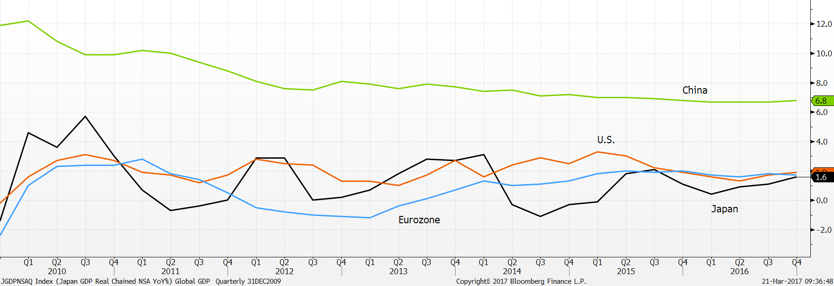
This Moderate Pace is Seen Elsewhere
Real YOY GDP Growth for Major Economies
(last obs. Dec. ‘16, China 6.8%, U.S. 1.9%, Eurozone 1.7%, Japan 1.6%)
Source: Bloomberg

Slide 6
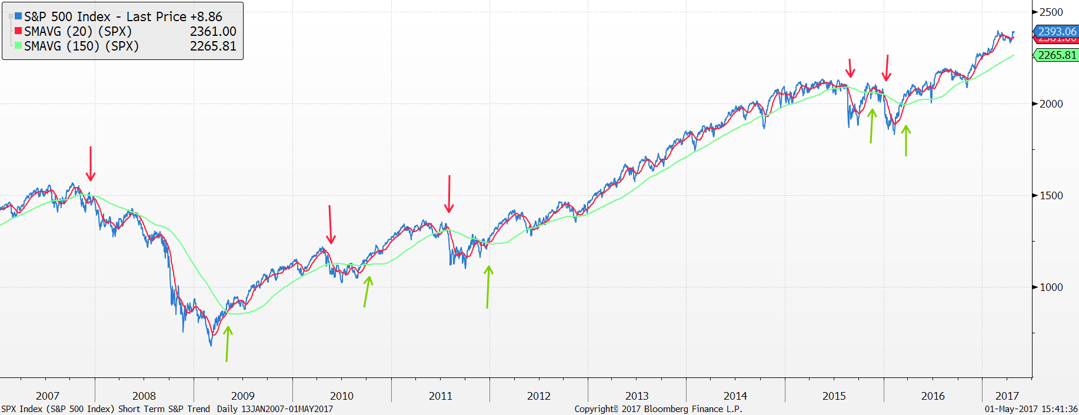
Positive Equity Market Trend is Intact
S&P 500 Index vs. 20- and 150-day moving averages
Source: Bloomberg

Slide 7
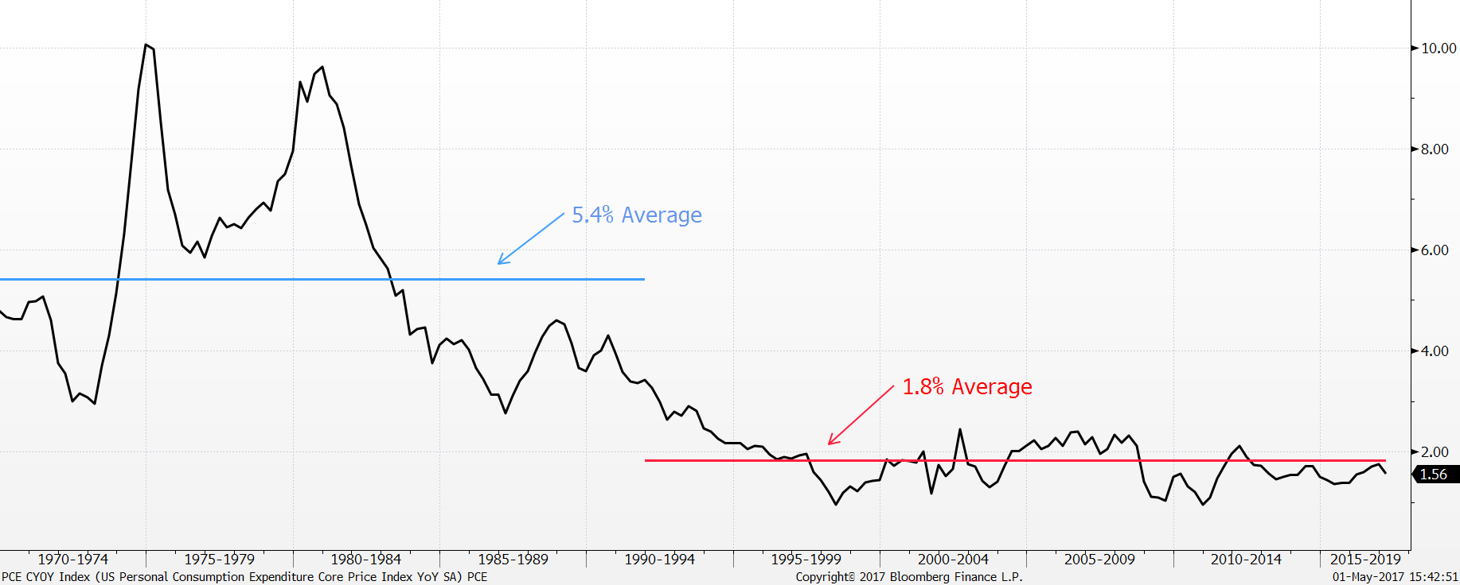
The Fed has Two Mandates
US Personal Consumption Expenditure Core Price Index YOY (%)
Source: Bloomberg
7

Slide 8
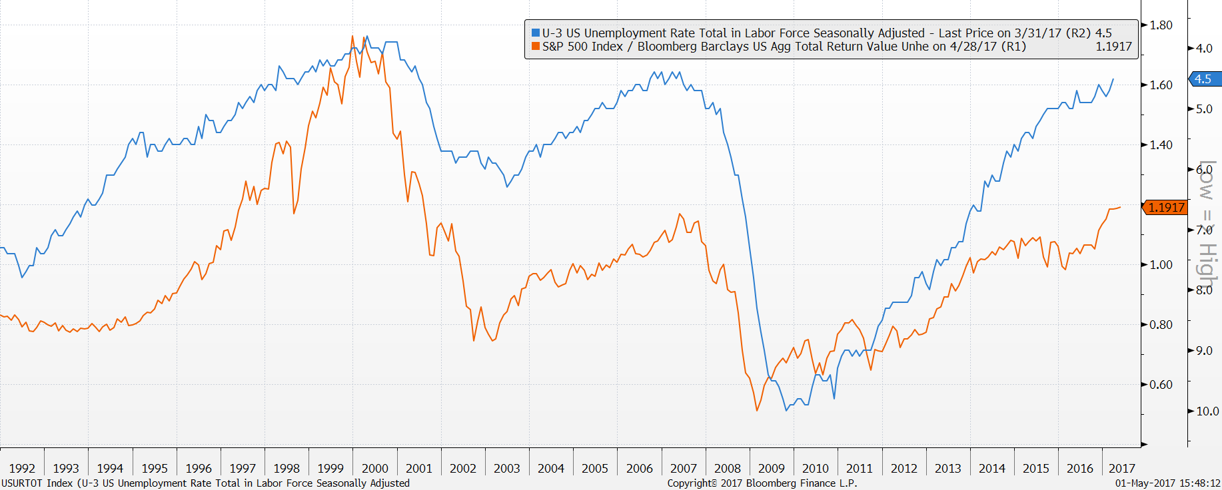
The Fed has Two Mandates
Without Inflation Employment is What Matters
Source: Bloomberg
8

Slide 9
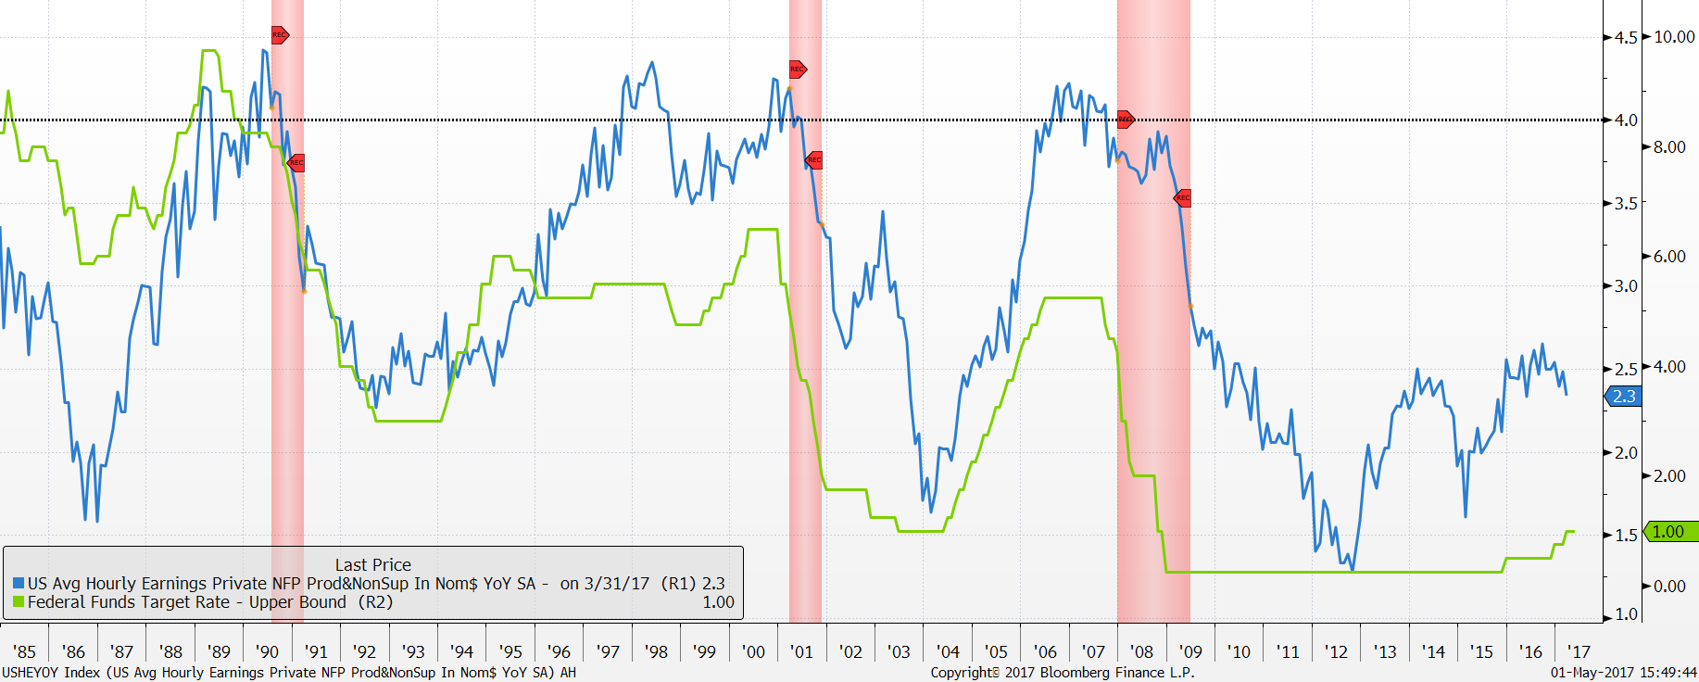
“Gradual” is the Operative Word
Fed Funds Target Rate vs. Average Hourly Earnings
Source: Bloomberg. Shaded bars represent recessions.

Slide 10
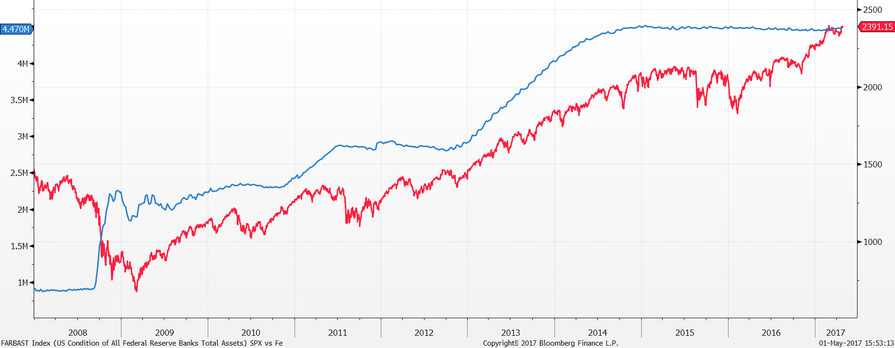
Equity Market Seemingly Less Tethered to Fed Balance Sheet
Federal Reserve Banks Total Assets (blue) vs. S&P 500 Index (red)
Source: Bloomberg.

Slide 11
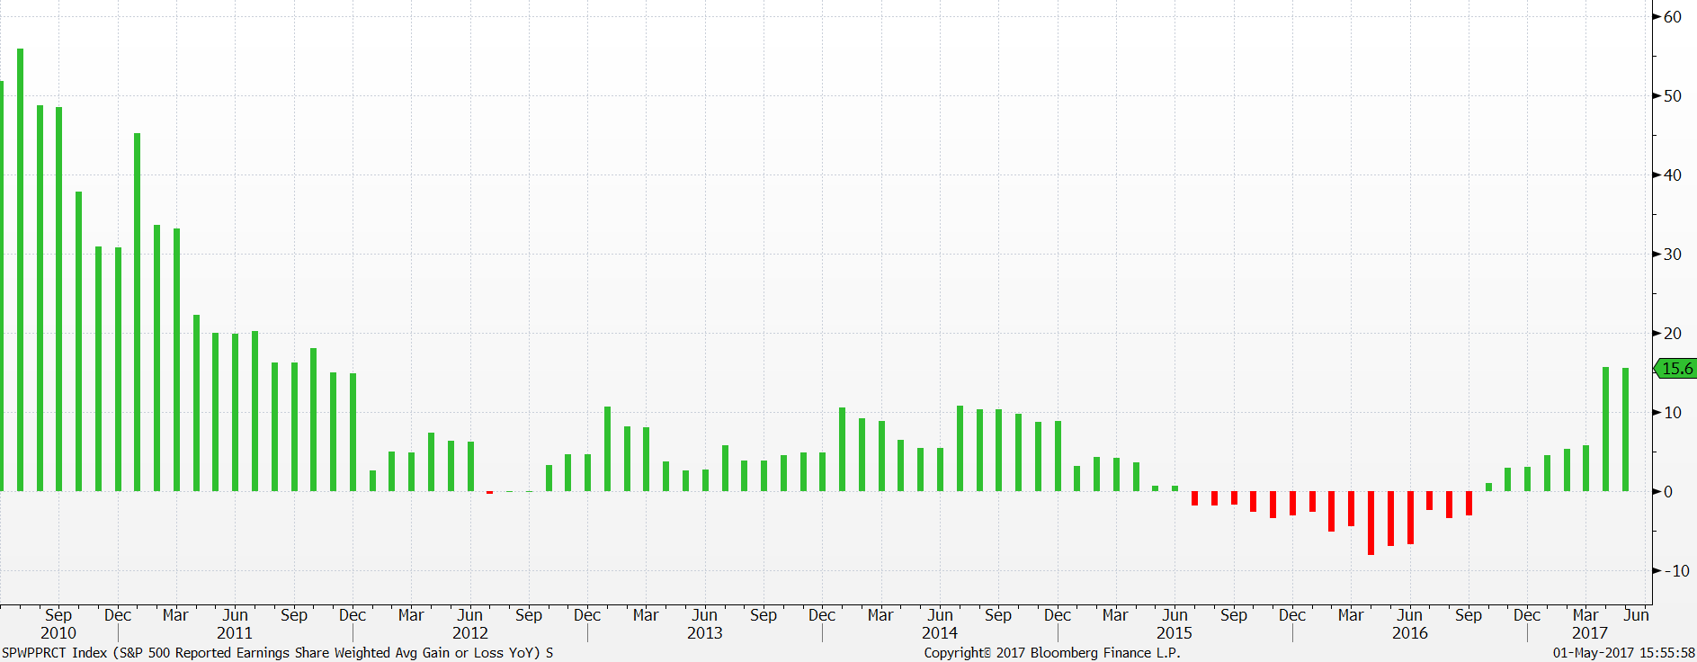
Mid-Cycle Slowdown in Corporate Earnings has Ended
S&P 500 Reported Earnings Weighted Avg. Gain or Loss YOY (%)
Source: Bloomberg.

Slide 12
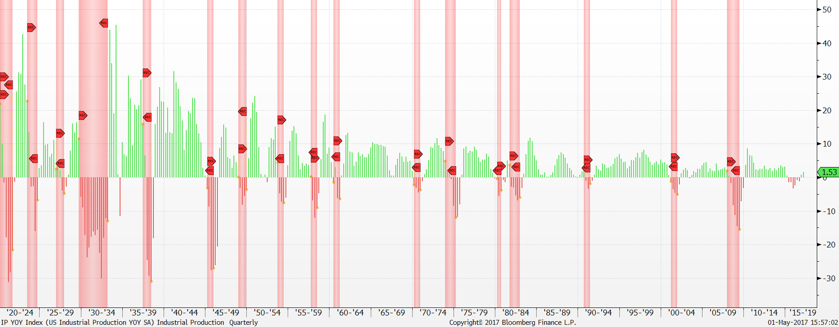
Industrial Production Recovered to Modestly Positive Pace
U.S. Industrial Production YOY (%)
Source: Bloomberg. Shaded bars represent recessions.

Slide 13
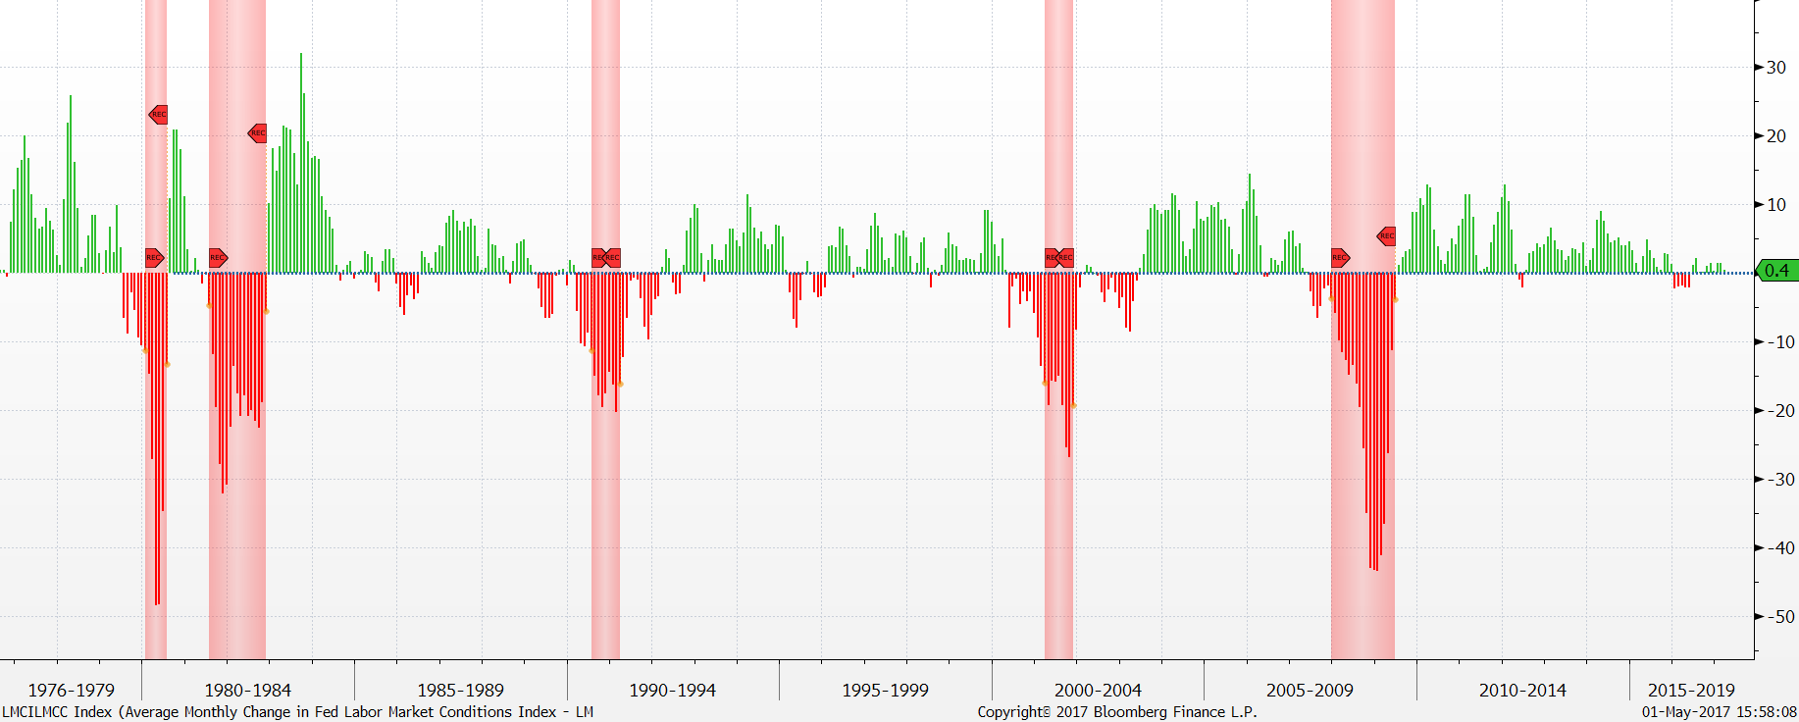
Labor Markets Showing Improvement
Average Monthly Change in Fed Labor Market Conditions Index
Source: Bloomberg. Shaded bars represent recessions.

Slide 14
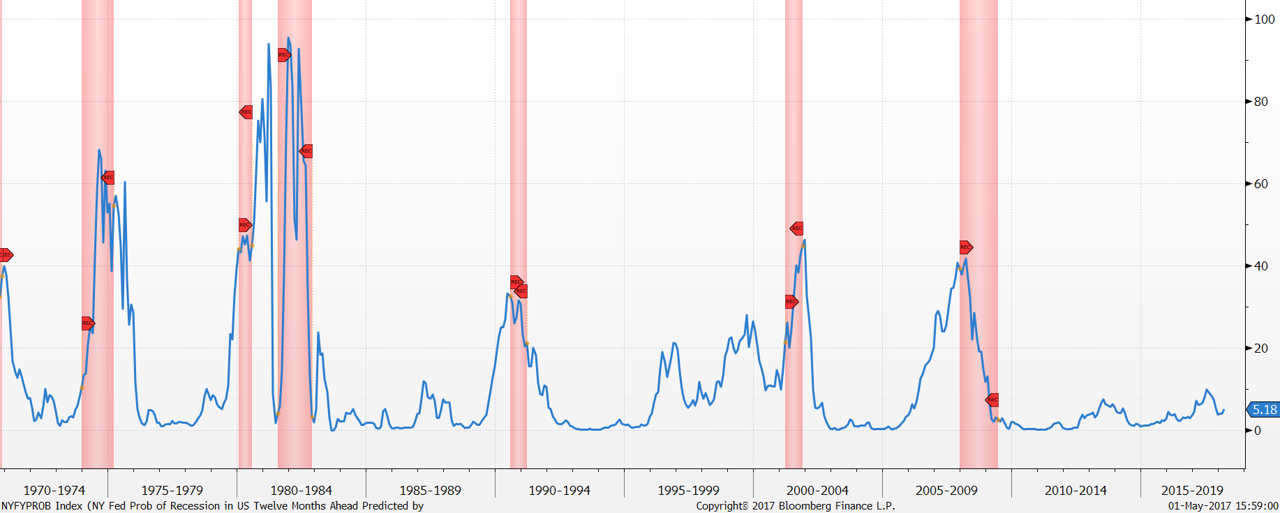
Near-Term Recession Risk is Low
NY Fed Probability of Recession in US 12 Months Ahead (%)
Source: Bloomberg. Shaded bars represent recessions.

Slide 15
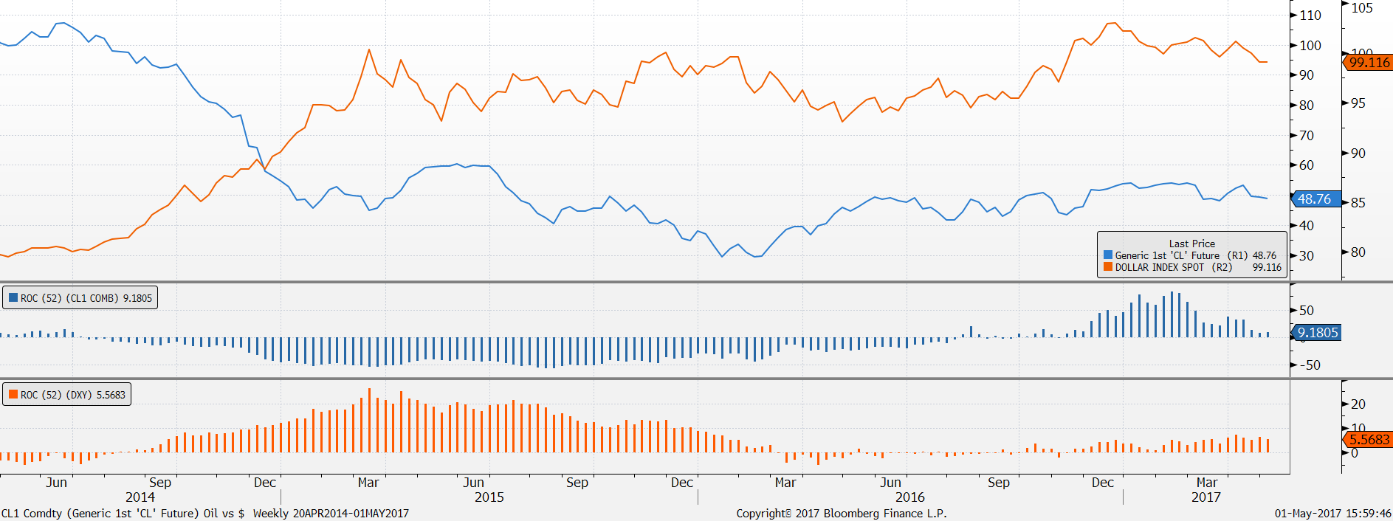
Oil Prices and the Dollar Were Two Contributors to the Earnings Slowdown
DXY Index vs. WTI Crude Oil
DXY = The US Dollar Index (USDX, DXY) is an index (or measure) of the value of the United States dollar relative to a basket of foreign currencies, often referred to as a basket of US trade partners' currencies.
Source: Bloomberg

Slide 16
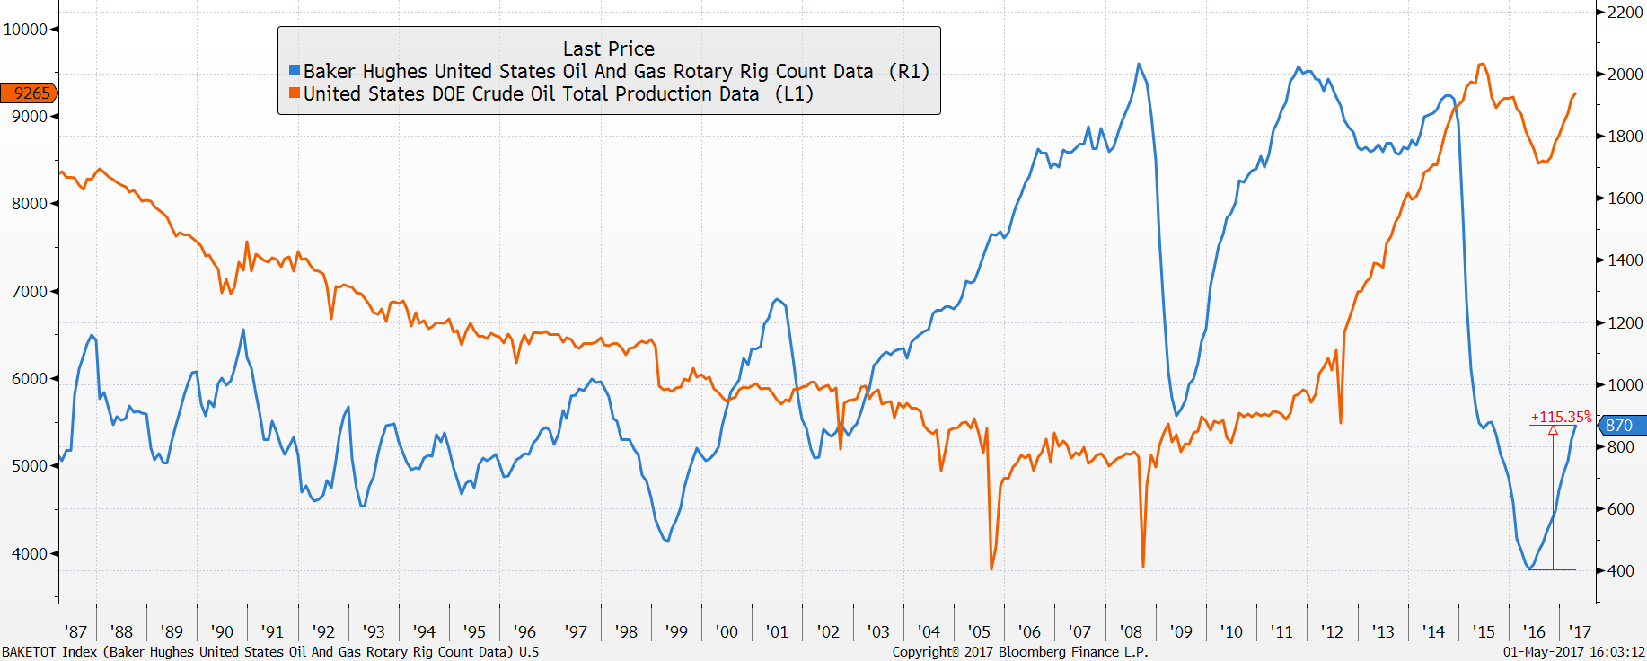
Oil Production Responding to Change in Price Trend
Rig Count and Production Improving
Source: Bloomberg. Shaded bars represent recessions.

Slide 17

2016 was a “Change” Election
Voters were unhappy:
76% were dissatisfied with the way things were going in the U.S.
70% felt that the country was on the wrong track
83% felt that the economy, defense and healthcare were the top issues that needed to be addressed
This was a “change” election:
Hillary Clinton was the “status quo” candidate
Donald Trump was the “change” candidate
Donald Trump is the 45th President of the United States
Source: Gallup Poll conducted Jan 6-10, 2016 of 1.012 adults nationwide. Margin of error is +/-4 percentage points. NBC/WSJ Survey as of December 15, 2015.

Slide 18
In 2016, Presidential Pendulum Swung Back to the Right
Presidency changes party every two terms
GOP
Dem

Slide 19
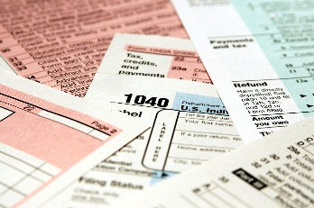
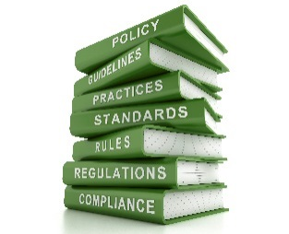
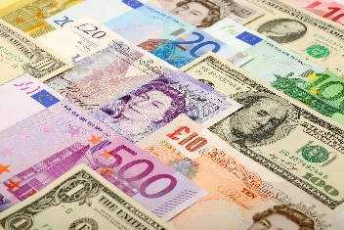

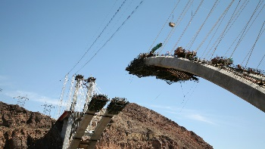

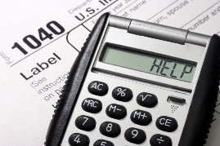


Key Elements of President Trump’s Ambitious Fiscal Policy Platform to
“Make American Great Again”
Corporate Tax Reform
Reduce Regulations
Repatriation of Cash
Expensing of New Equipment
Increase Infrastructure Spending
Strengthen National Security
Personal Tax Reform
Immigration Reform
Fix Health Care
  INSTITUTIONAL Sales Material. Not for Distribution to the Public.
.

Slide 20
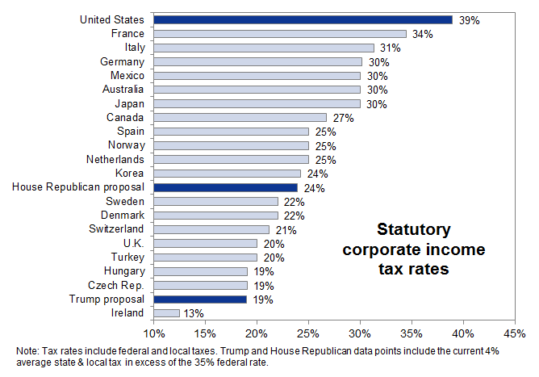
U.S. has World’s Highest OECD Combined Corporate Tax Rate
Source: Organization for Economic Co-Operation and Development (OECD), Goldman Sachs Global Investment Research

Slide 21
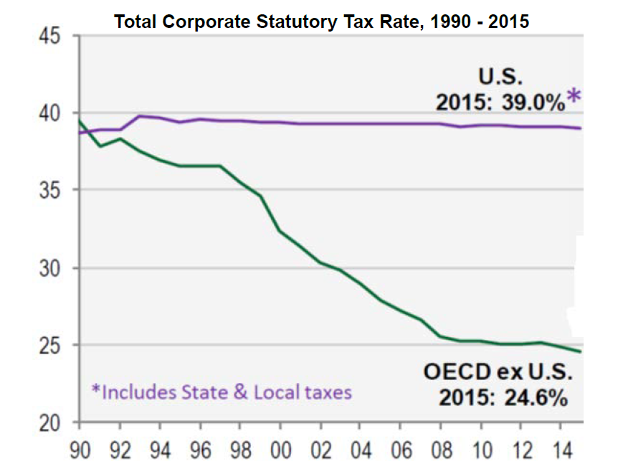
The World Has Changed, But We Haven’t
Source: Cornerstone Macro, January 2017
  INSTITUTIONAL Sales Material. Not for Distribution to the Public.
.

Slide 22
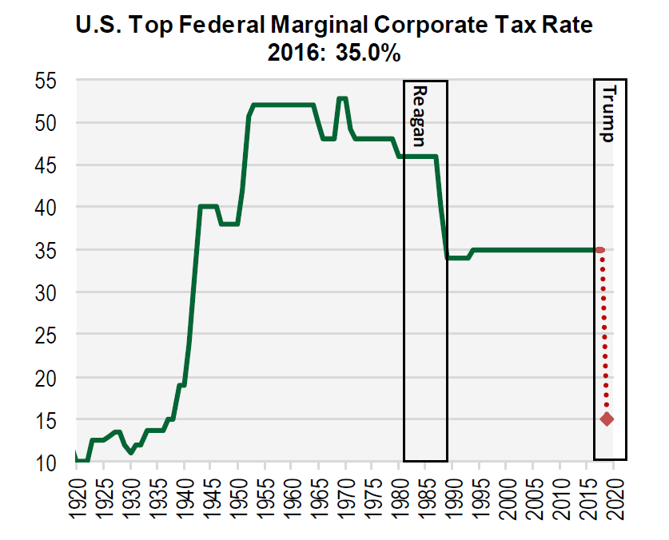
Putting the Proposed Corporate Tax Cuts Into a Longer-Term Perspective
Source: Cornerstone Macro as of January 4, 2017
  INSTITUTIONAL Sales Material. Not for Distribution to the Public.
.

Slide 23
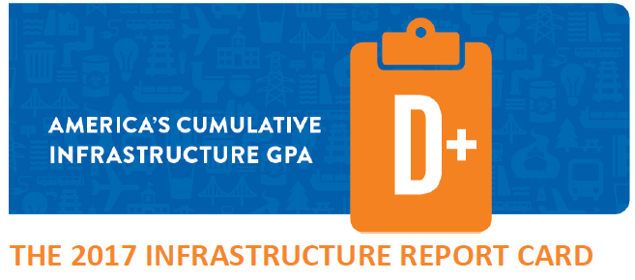
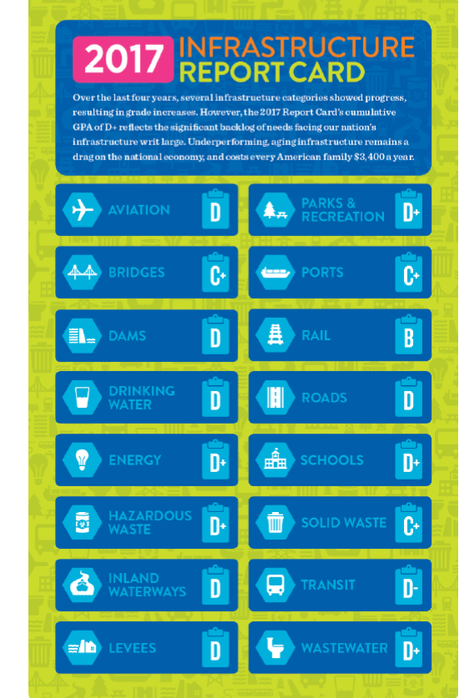
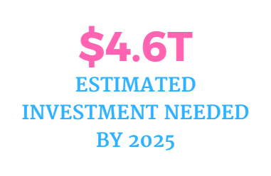
Infrastructure Spending Is Needed to Improve Productivity
Source: American Society of Civil Engineers, 2017

Slide 24
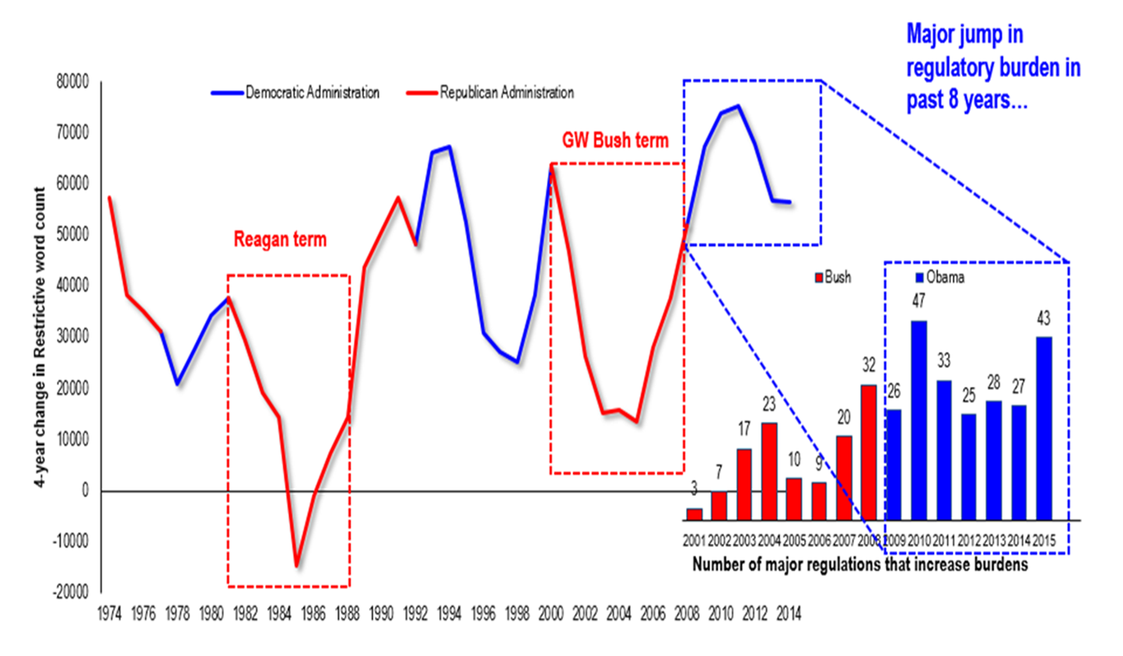
Pace of Federal Regulations, Which Has Doubled Over the Last Eight Years, is at a Half-Century Peak
Source: Fundstrat, as of February 3, 2017
  INSTITUTIONAL Sales Material. Not for Distribution to the Public.
.

Slide 25
Confidence Metrics Have Surged Since the Election
13-year high
17-year high
58-year high
12-year high
13-year high
Michigan Consumer Sentiment Index
Conference Board’s Consumer Confidence Index
Leading Economic Indicators
NAHB’s Housing Market (HMI) Builder-Confidence Index
NFIB Small Business Optimism Index
Oct. 16
98.5
124.9
126.7
71
105.9
87.2
Jan. 17
Oct. 16
Aug. 16
Mar. 17
Jul. 16
Mar. 17
Sep. 16
Jan. 17
Jan. 17
100.8
Mar. 17
58
57.4
123.4
94.1
6-year high
3-year high
3-year high
34-year high
ISM Non-Manufacturing Business Activity Index
ISM Manufacturing Index
Empire Regional Manufacturing Index
Philadelphia Regional Manufacturing Index
63.6
57.7
18.7
43.3
Aug. 16
Feb. 17
Feb. 17
Oct. 16
Feb. 17
Jul. 16
Feb. 17
52.4
49.4
(5.5)
(2.9)
Chicago Regional Manufacturing Index
Kansas City Regional Manufacturing Index
Richmond Regional Manufacturing Index
Dallas Regional Manufacturing Index
58.3
20
24.5
Aug. 16
Apr. 17
Jul. 16
Mar. 17
Aug. 16
22
Aug. 16
Feb. 17
51.6
(5)
(11)
Mar. 17
(4.8)
2-year high
6-year high
7-year high
11-year high
  INSTITUTIONAL Sales Material. Not for Distribution to the Public.
.

Slide 26
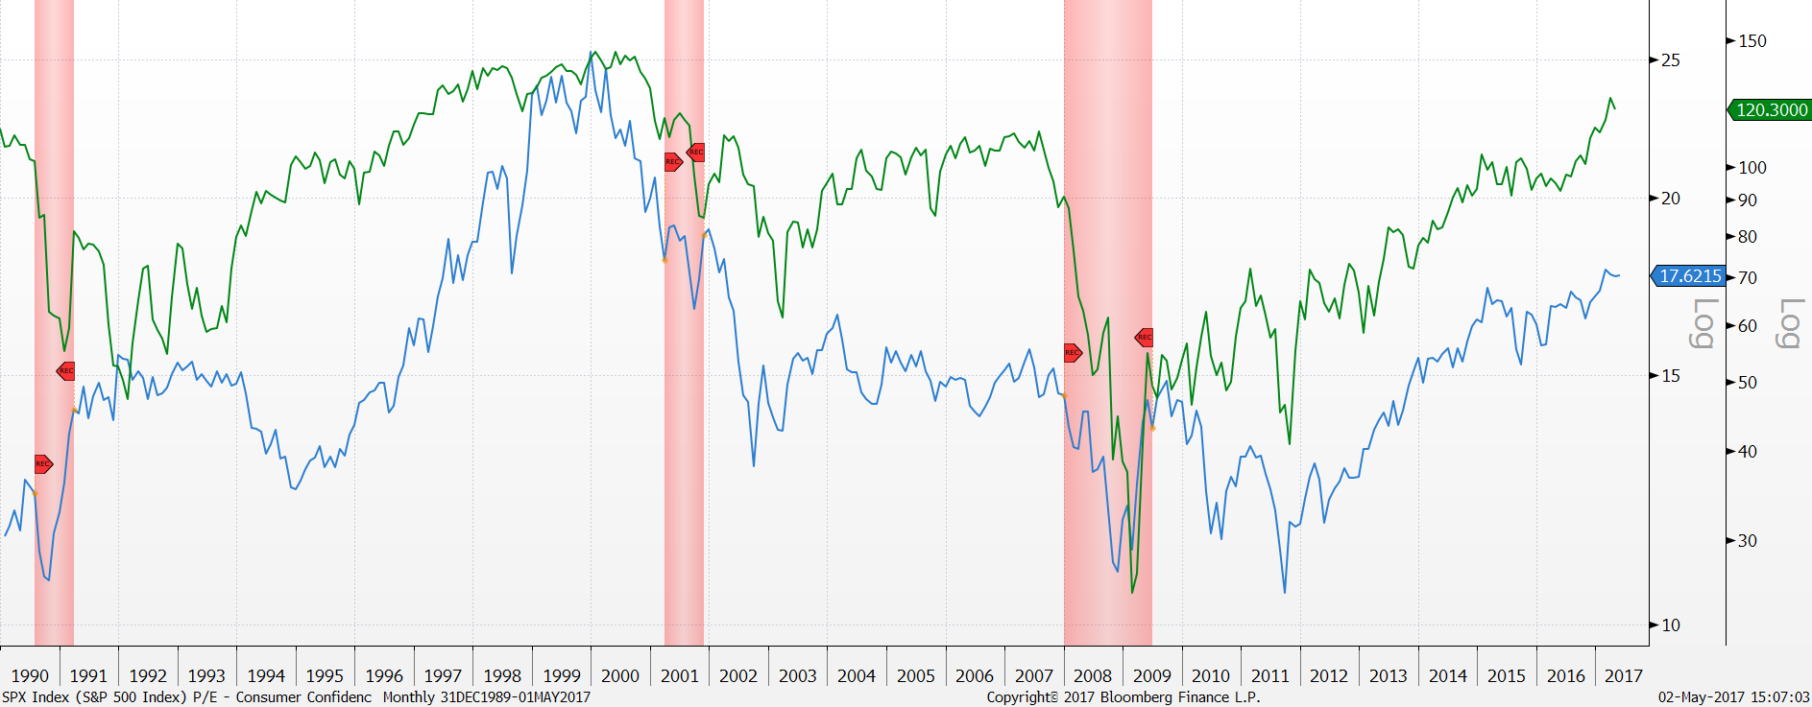
Confidence Can Mean Higher P/E’s…
Conference Board Consumer Confidence (green) vs. S&P 500 Forward P/E Ratio (blue)
Source: Bloomberg. Shaded bars represent recessions.

Slide 27
And Better Capital Spending…
Source: Haver Analytics, Citi Research – US Equity Strategy.

Slide 28
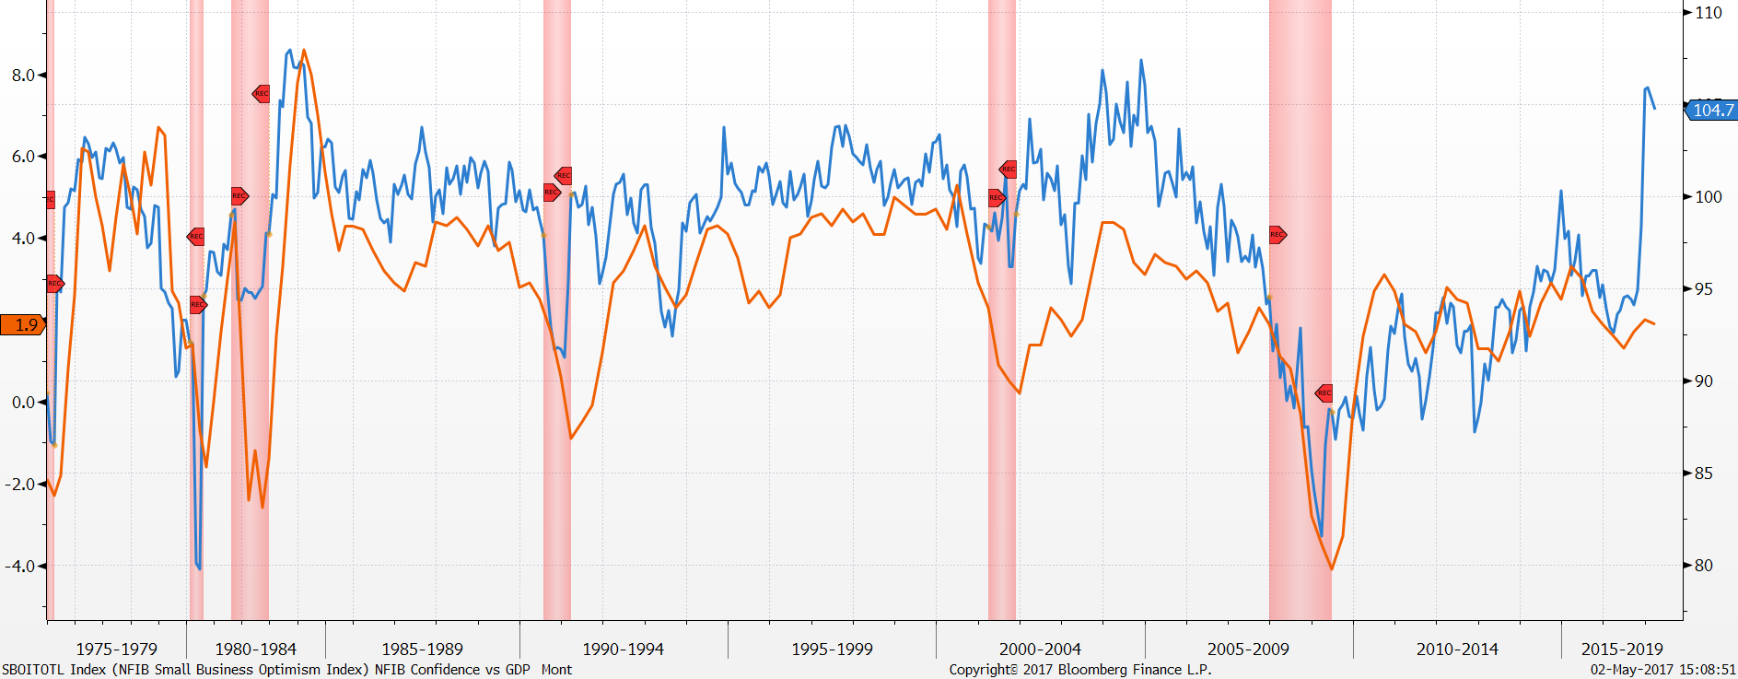
And Better Growth
NFIB Small Business Optimism Index (blue) vs. US GDP YOY (%, orange)
Source: Bloomberg. Shaded bars represent recessions.

Slide 29
What are We Watching?
Innumberable Political and Geopolitical Issues
  Scope and Timing of Domestic Policy
    Healthcare
    Taxes
    Immigration
    Protectionism – Border Tax/Tariffs
    Reduced Regulation
    Infrastructure
  European Elections
  China

Slide 30
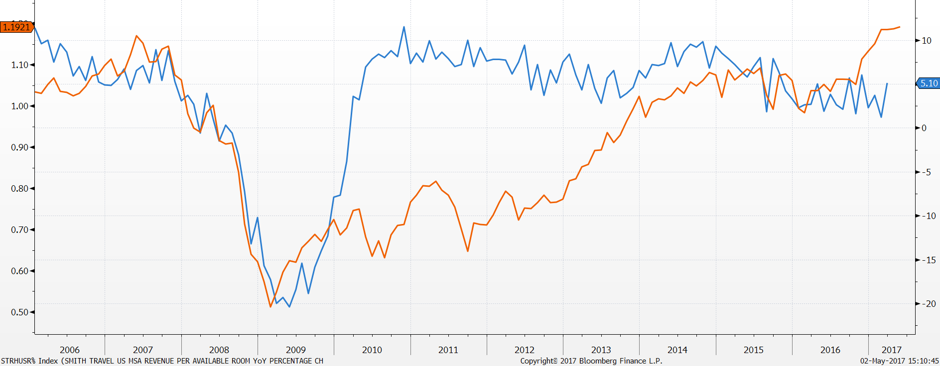
And Plenty of Economic Concerns
Smith Travel US RevPar YOY (blue, %) vs. S&P 500 Index/Barclays US Aggregate Bond Index(orange)
Source: Bloomberg

Slide 31
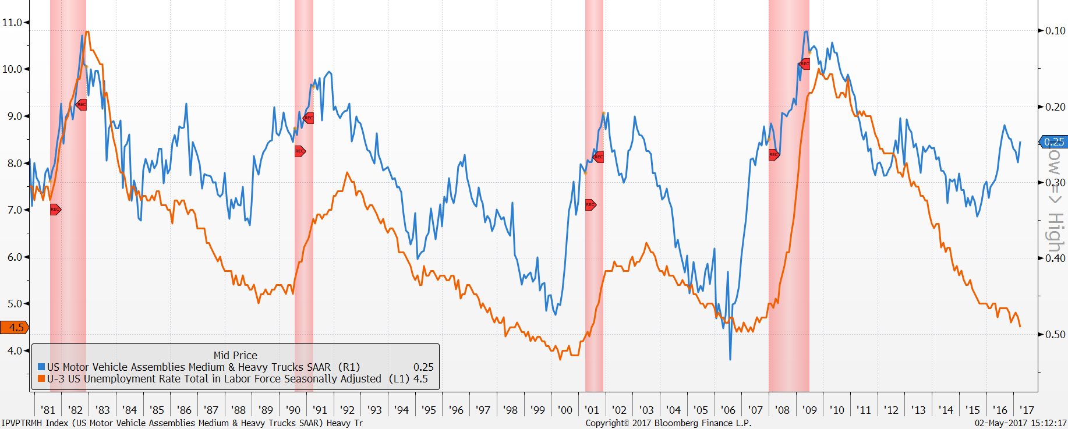
Truck Production Slowed Significantly in 2016
Source: Bloomberg. Shaded bars represent recessions.

Slide 32
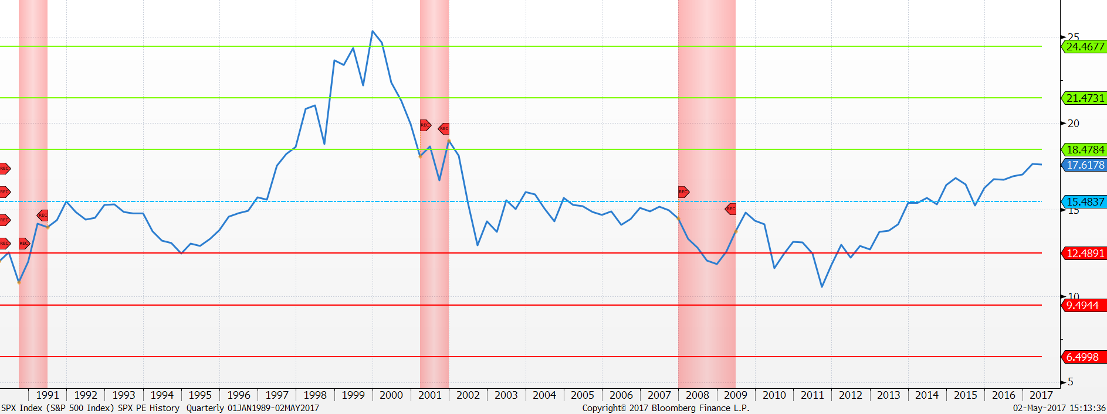
U.S. Equity Valuations are High Relative to Recent Past
S&P 500 Index Forward P/E Ratio
Source: Bloomberg

Slide 33
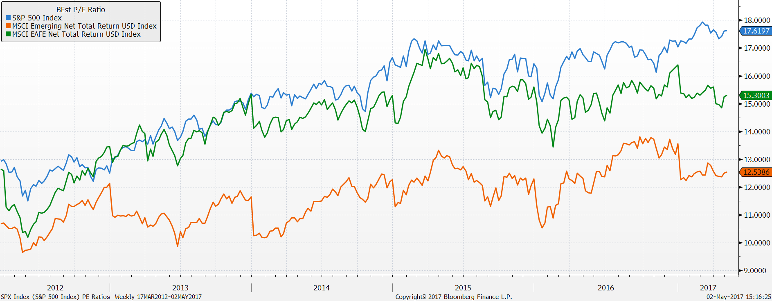
And Relative to Other Markets
Source: Bloomberg

Slide 34
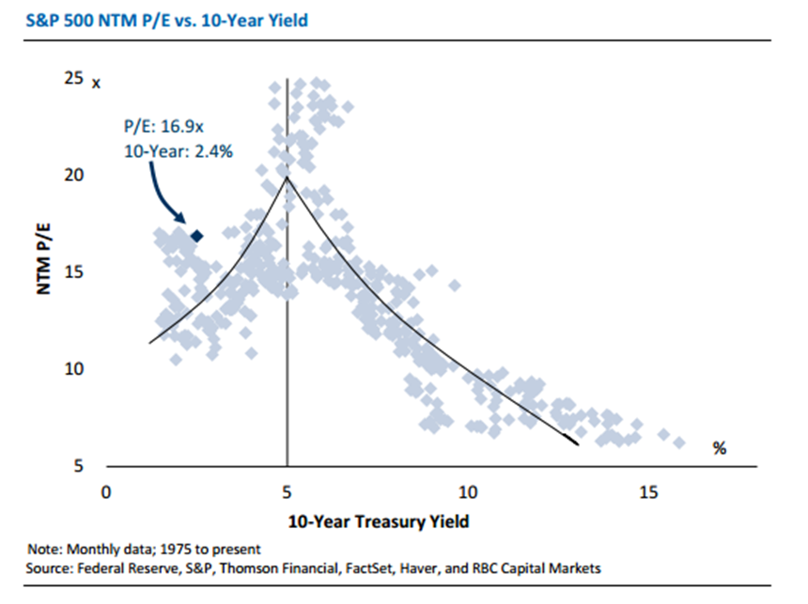
Sweet Spot for P/E’s Until 10-Year Treasury Yields Hit 5%
Source: RBC, as of January 2017
  INSTITUTIONAL Sales Material. Not for Distribution to the Public.
.

Slide 35
Federated Equity Forecasts
2016
1.60%
$2,250
2018
2.90%
$2,500
2019-2020
3.00-4.00%
$3,000
2017
1.60%
2.50%
$118
19.5x
2.00%
3.50%
$140
18.0x
2.25-2.50%
4.00-5.00%
$150
20.0x
2.30%
1.80%
3.00%
$130
18.0x
$2,350
Real GDP
Core PCE
Benchmark 10yr Treasury Yield
S&P 500 EPS
Target P/E
S&P 500 Target Price
PCE = Personal Consumption Expenditures. Views are as of 5/2/2017
  INSTITUTIONAL Sales Material. Not for Distribution to the Public.
.

Slide 36
Current Fund Positioning
3/31/17 Federated MDT Balanced Fund Asset Allocation (%)
Overweight Equities
  Favor Value over Growth
  Overweight Small Caps
Overweight Domestic vs. International
Underweight Fixed Income
  Short Duration
  Overweight Credit
Neutral REITs
  Low Duration Mortgage REITs
Overweight Cash
Portfolio holdings are subject to change. The holdings percentages are based on net assets at the close of business on 3/31/17 and may not necessarily reflect adjustments that are routinely made when presenting net assets for formal financial statement purposes.
36

Slide 37
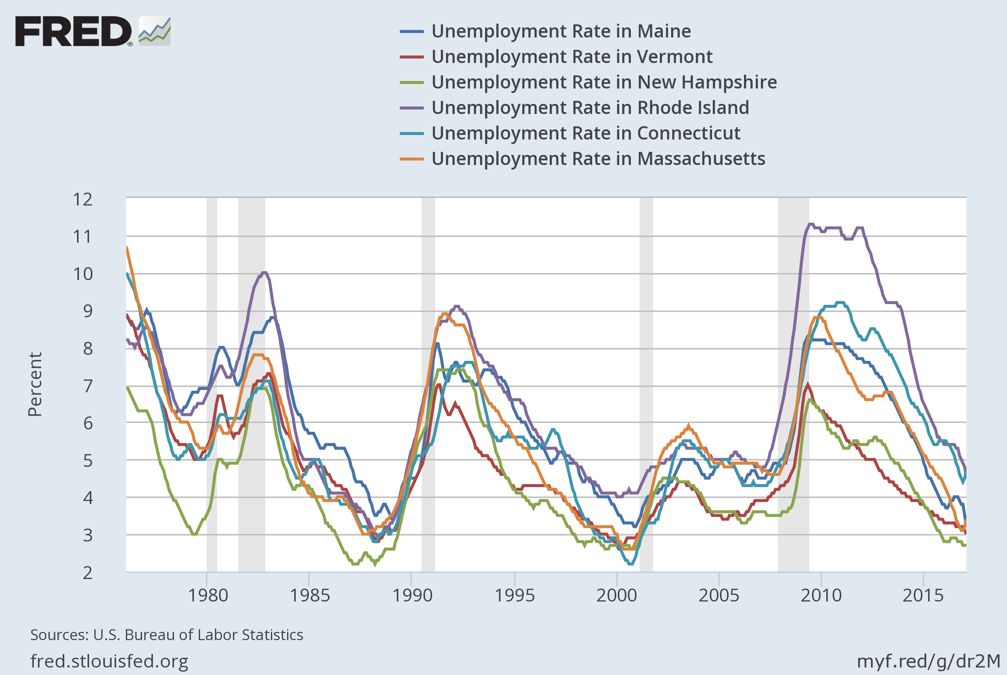
New England Economy:
Source: U.S. Bureau of Labor Statistics as of March 31, 2017. Shaded areas indicate recessions.

Slide 38
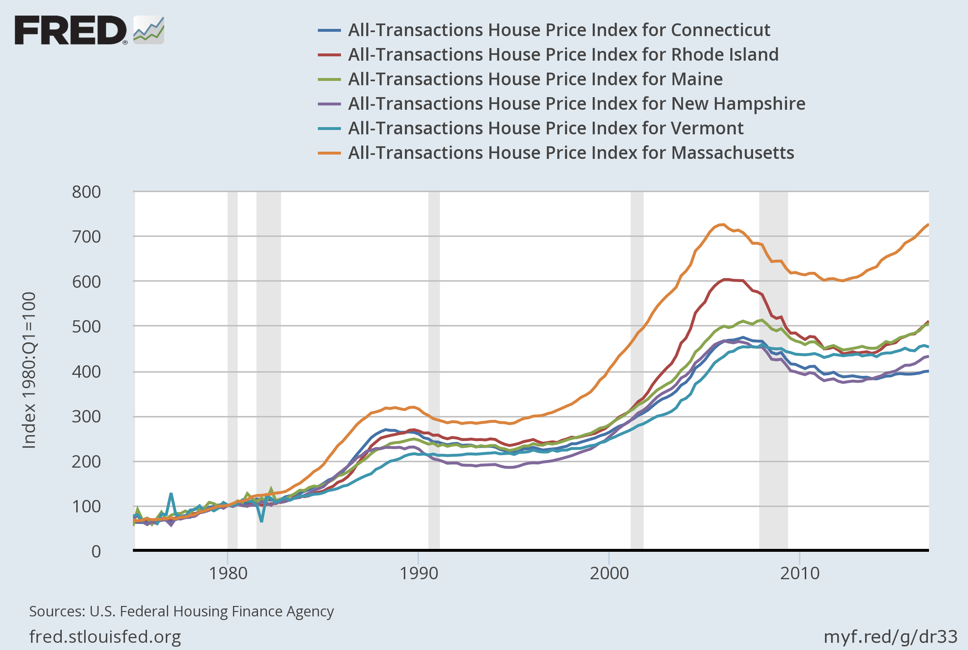
New England Economy:
Source: U.S. Federal Housing Finance Agency as of March 31, 2017. Shaded areas indicate recessions.

Slide 39
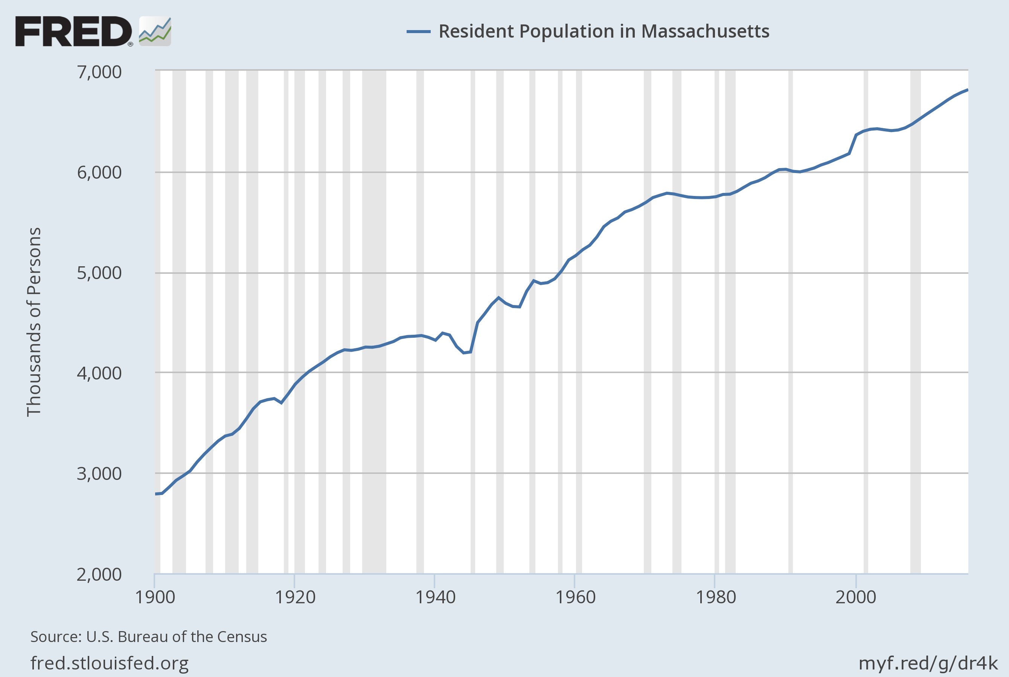
New England Economy: Massachusetts
Source: U.S. Bureau of the Census as of March 31, 2017. Shaded areas indicate recessions.

Slide 40
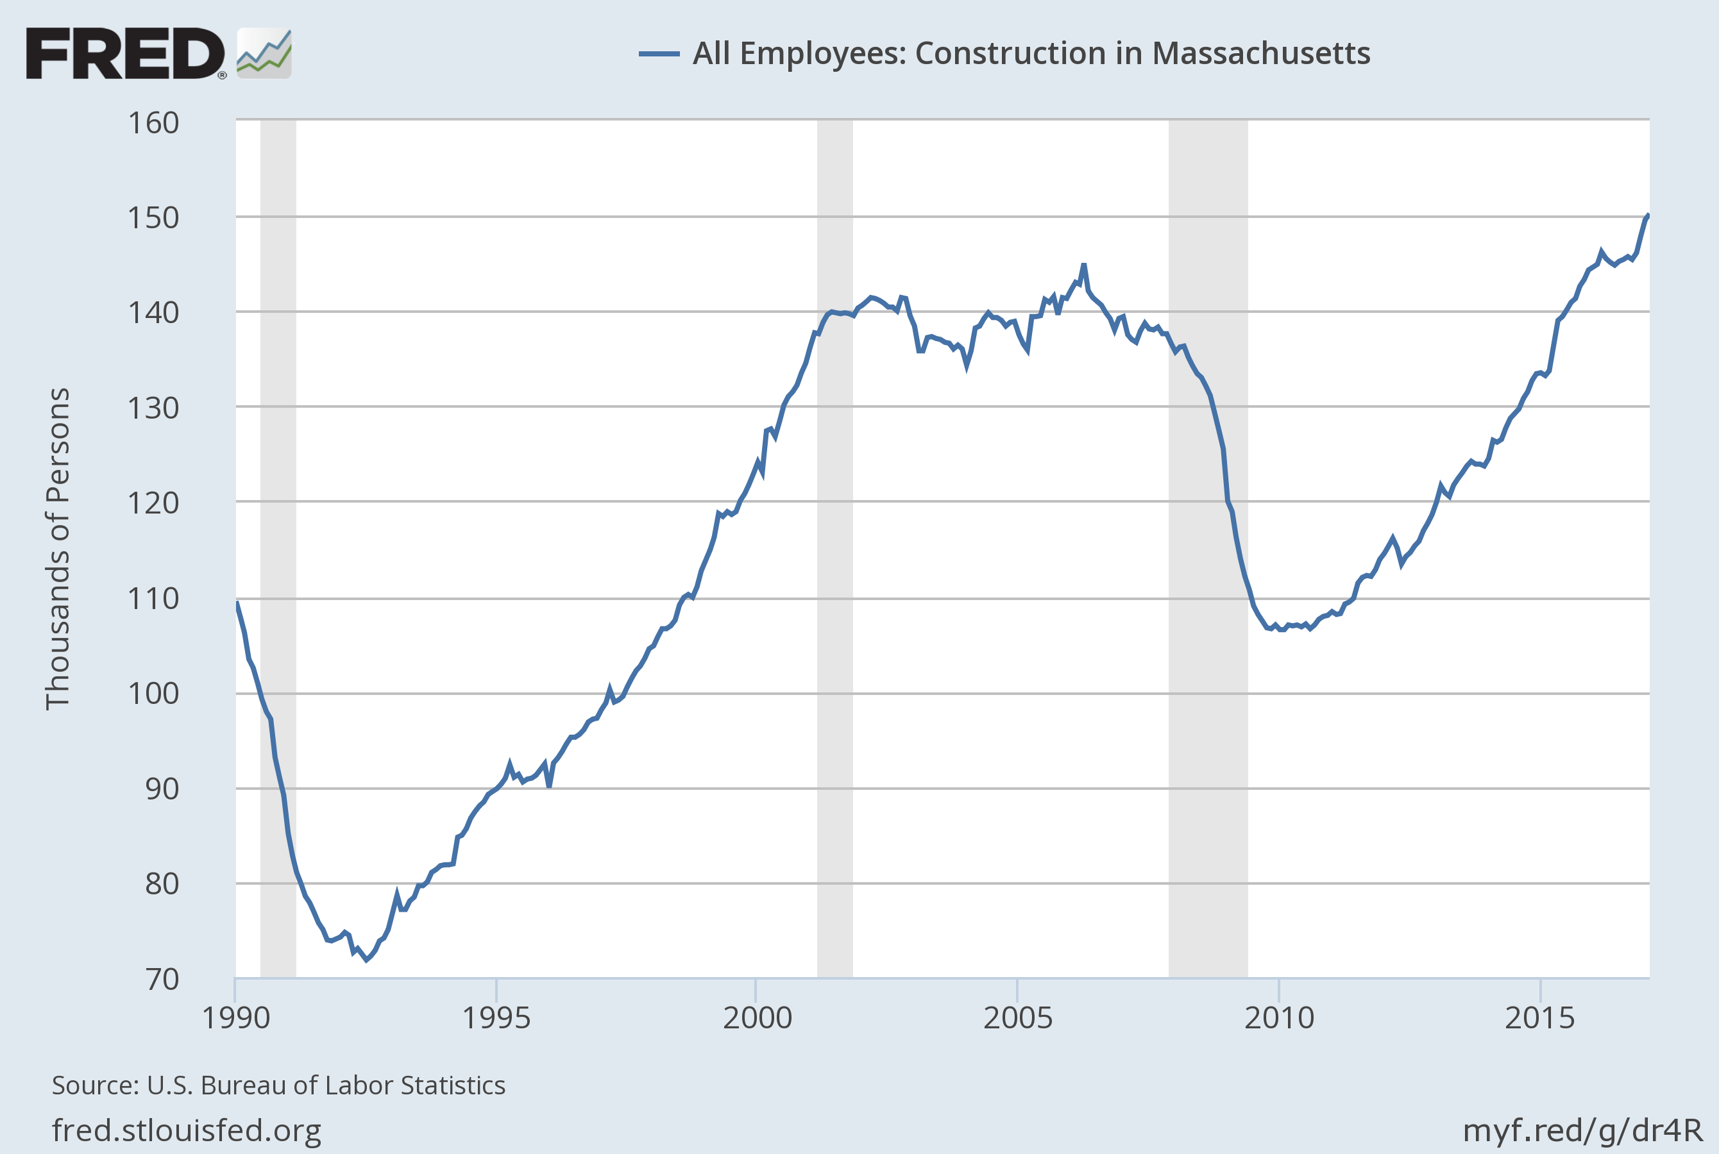
New England Economy: Massachusetts
Source: U.S. Bureau of Labor Statistics as of March 31, 2017. Shaded areas indicate recessions.

Slide 41
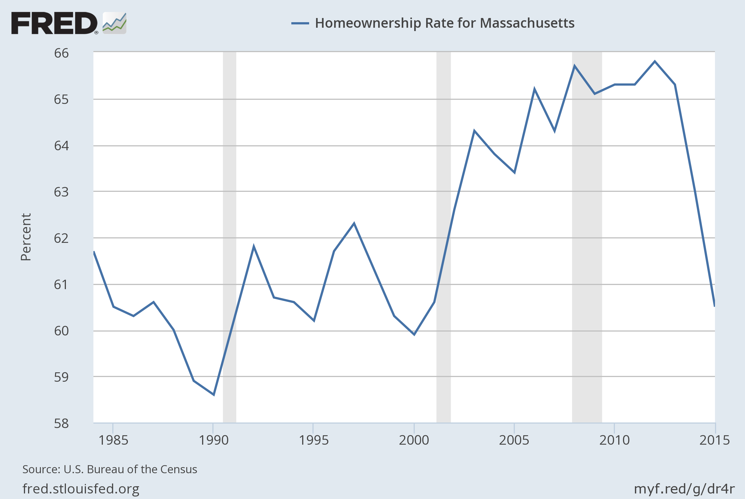
New England Economy: Massachusetts
Source: U.S. Bureau of the Census as of March 31, 2017. Shaded areas indicate recessions.

Slide 42
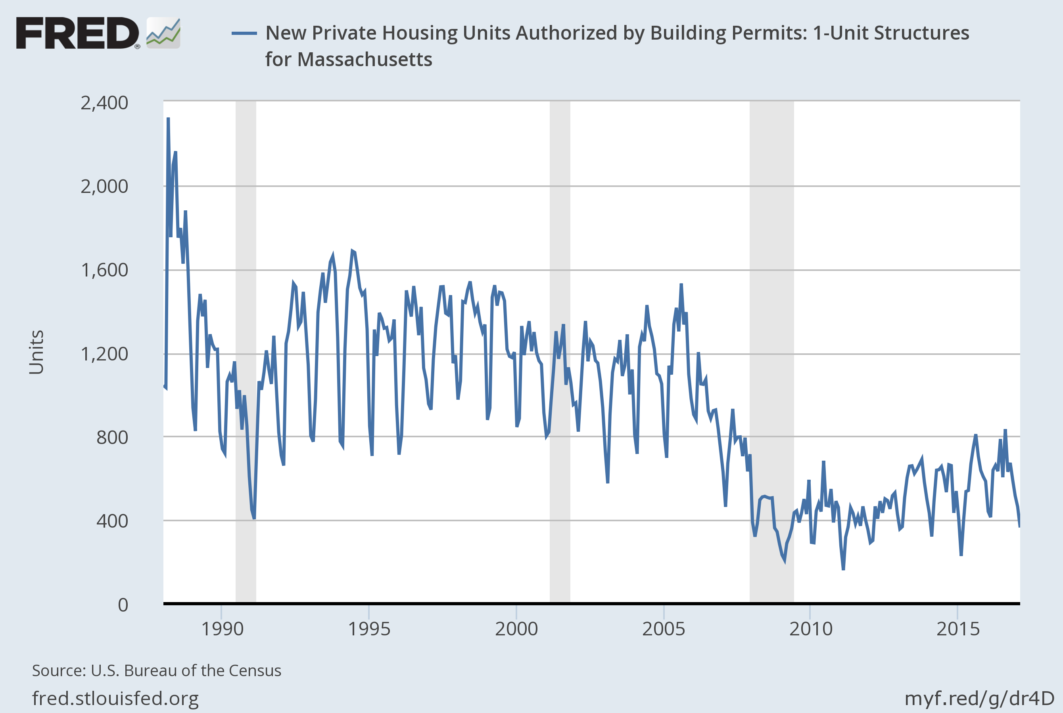
New England Economy: Massachusetts
Source: U.S. Bureau of the Census as of March 31, 2017. Shaded areas indicate recessions.

Slide 43
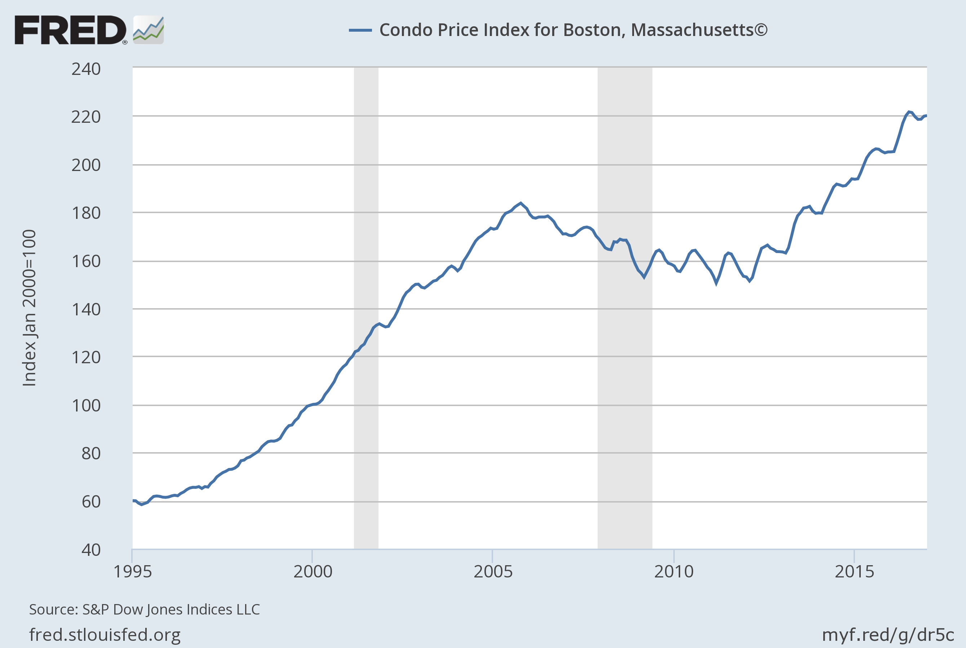
New England Economy: Massachusetts
Source: S&P 500 Dow Jones Indices as of March 31, 2017. Shaded areas indicate recessions.

Slide 44
Biography
John F Sherman, CFA Vice President, Senior Portfolio Manager
Current Responsibilities | Mr. Sherman serves as Senior Portfolio Manager of the Federated MDT Balanced Fund (QIBGX). He has been responsible for asset allocation decisions as well as managing the fund’s Real Estate Investment Trust investments since its inception in 2002. He is a member of Federated’s Balanced/Macro team, participates in the firm’s Macro Economic and Prism Allocation committees, and is a frequent conference speaker on topics related to economic and market conditions.
Previous Responsibilities | Prior to joining Federated in 2006, Mr. Sherman served as a Portfolio Manager with MDT Advisers managing both balanced and fixed income strategies. Additional experience includes Senior Analyst positions with Citizens Financial Group and the Federal Deposit Insurance Corporation.
Education & Professional Affiliations | Mr. Sherman received a master’s degree in business administration from the Boston University Graduate School of Management and a bachelor’s degree from North Adams State College with concentrations in finance and economics. He is a CFA charterholder and a member of the CFA Society Boston.
Personal | Mr. Sherman is married and has three sons. He serves on the Advisory and Finance Committees of Cape Cod Village, an organization dedicated to meeting the ongoing community and residential needs of adults on the autism spectrum.

Slide 45
Fund Description
Federated MDT Balanced Fund Morningstar 50% - 70% Equities Category: Diversified, institutional approach to traditional balanced strategy. Features macro-driven tactical allocation positioning anchored by fundamental, bottom-up stock-selection process. Benchmark: 60/40 S&P 500 / Bloomberg Barclays U.S. Aggregate Index.
Mutual funds are subject to risks and fluctuate in value.
The quantitative models and analysis used by the fund may perform differently than expected and negatively affect fund performance.
Bond prices are sensitive to changes in interest rates, and a rise in interest rates can cause a decline in their prices.
High-yield, lower-rated securities generally entail greater market, credit/default and liquidity risks and may be more volatile than investment-grade securities.
    The fund is the successor to the MDT Balanced Fund pursuant to a reorganization that took place on December 8, 2016. Prior to that date, the fund had no investment operations. Accordingly, the performance information shown for periods prior that date is that of the MDT Balanced Fund.
Investors should carefully consider the fund’s investment objectives, risks, charges, and expenses before investing. To obtain a prospectus containing this and other information, contact us or visit FederatedInvestors.com. Please carefully read the prospectus before investing.
© 2017 Morningstar, Inc. All Rights Reserved. The information contained herein: (1) is proprietary to Morningstar; (2) may not be copied or distributed; and (3) is not warranted to be accurate, complete or timely. Neither Morningstar nor its content providers are responsible for any damages or losses arising from any use of this information. Past performance is no guarantee of future results.
  .

Slide 46

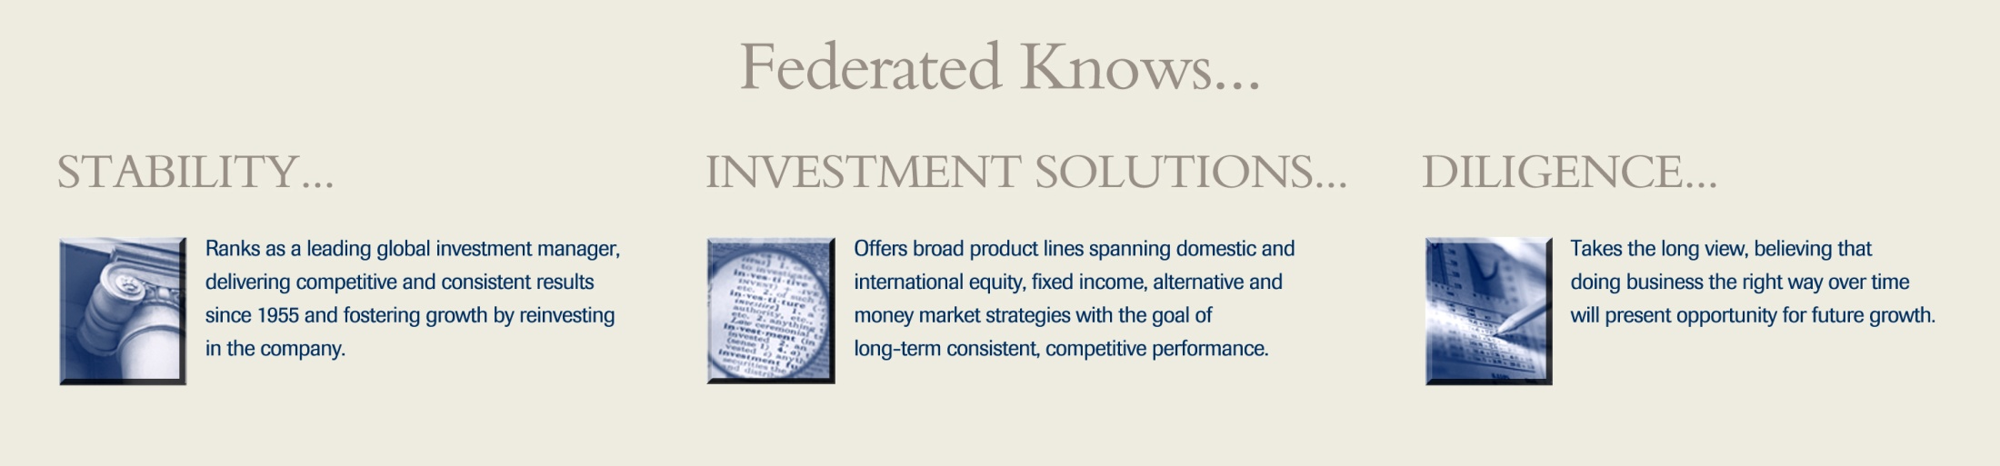
Federated is a registered trademark of Federated Investors, Inc.
46

