Slide 1


ANNUAL OPERATING & CAPITAL BUDGET PROCESS

Slide 2

THE BUDGET PROCESS
Spring Budget Process
Fall Budget Adjustment Process
Identify Budget Constraints (Tax Levy, Local Receipts, State Aid, etc.)
Refine Based on Budget Constraints
Develop Departmental Budgets
Submit to City Council for Review and Approval
Develop City Priorities for Operating & Capital Needs
Identify Fixed Costs (Education Funding, Debt Service, Pension Obligations, etc.)
Identify Cherry Sheet Adjustments & Additional Funds (Free Cash, etc.)
Identify Previously Unfunded Departmental Requests or New Needs
Submit to City Council for Review and Approval

Slide 3
BUDGET SCHEDULE – OPERATING & CAPITAL
November
City Manager establishes FY Budget priorities
December
FY Budget materials are distributed to departments
January
Departments submit FY Budget requests
February
FY Budget requests are presented to the City Manager
March
FY Budget meetings are held with departments
Preliminary FY revenues are established
April
FY Budget is finalized
May
FY Budget submitted to City Council
June
FY Budget Hearings continue
July
FY Budget is effective July 1st
FY Budget is voted by City Council
FY Budget Hearings

Slide 4
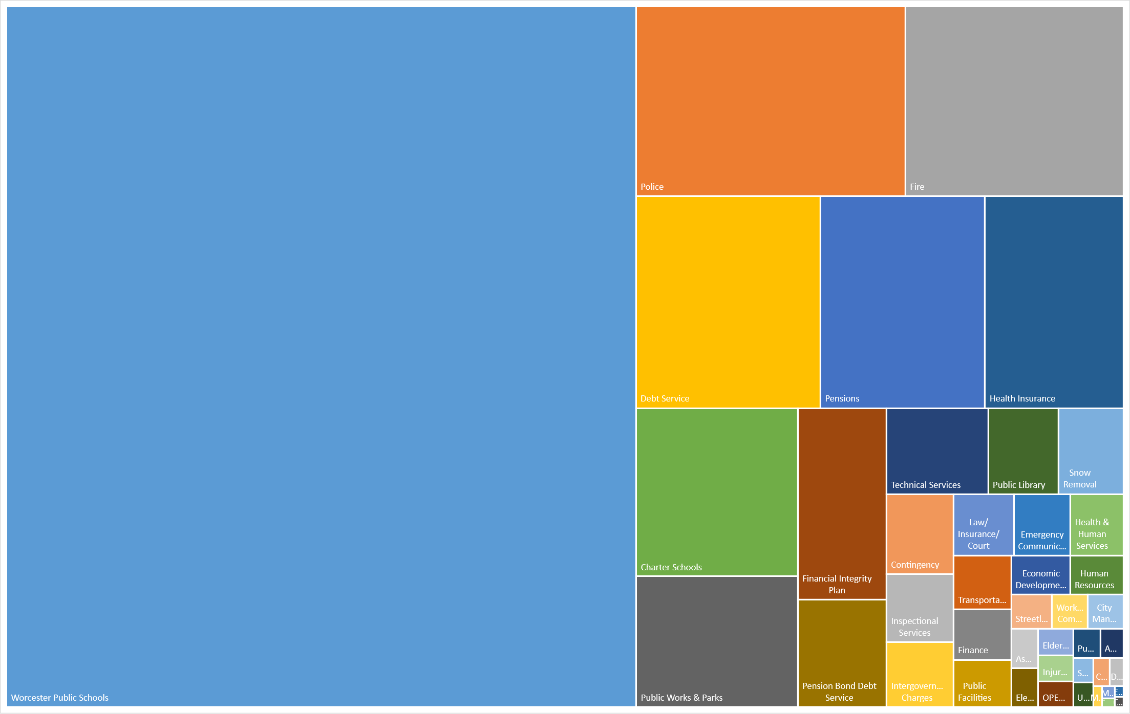
FY2024 OPERATING BUDGET $847.7M

Slide 5
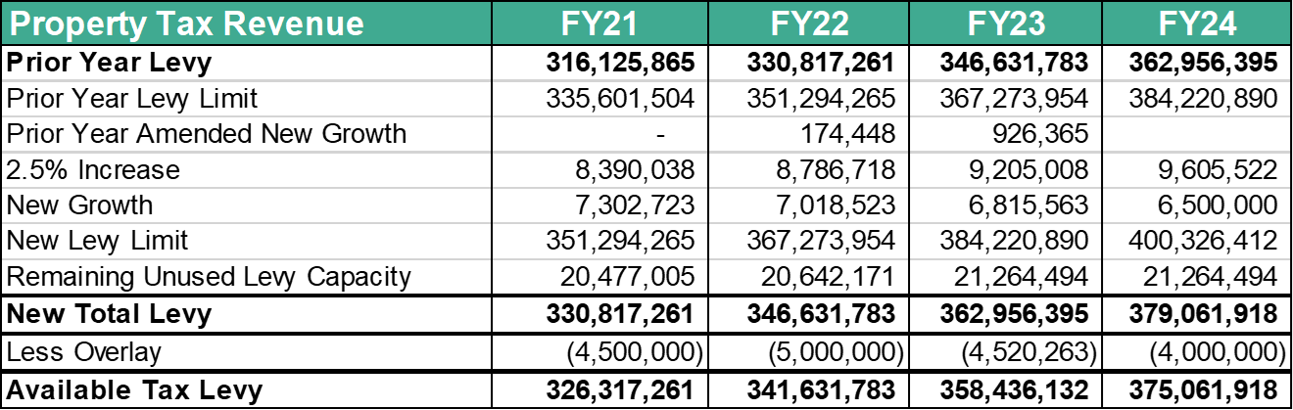
OPERATING REVENUES
Tools for Revenue Projections
Property Taxes
Table automatically updates based on formulas
  New Growth and Overlay are hardcoded
State Aid
Cherry Sheets
Local Receipts
Historical analysis
Current FY projections
Department Coordination
  Changes in revenue generating programs/services
  Updated fee schedules

Slide 6
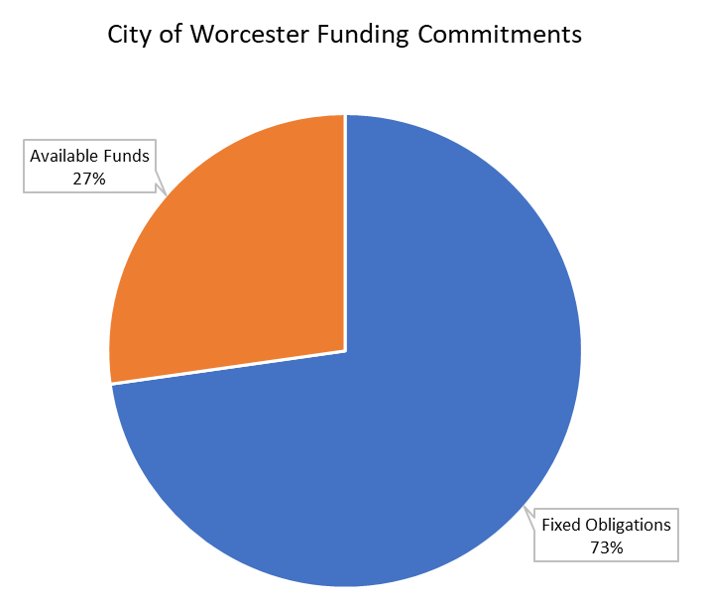
FIXED OBLIGATIONS
Tools for Fixed Obligation Commitments:
Public School Contributions
  Foundation Budget
  Net School Spending
Financial Integrity Plan
  Required contributions to reserves, OPEB, etc.
Debt
  Access database of all debt schedules
Retirement Contributions
  PERAC Contribution Requirements
    Less offsets (grants, enterprises, etc.)
Health Insurance
  Projections based on enrollment, claims, and market trends

Slide 7
DEPARTMENT OPERATING BUDGETS
Status Quo Budgets
  Departmental files are updated on a weekly basis and include the following information:
    Line item budget for every position (Salary by Name)
    Salary and overtime projections (current and future year)
    Table of Organization
    Operating (OM) historical analysis and future projections
    Departmental revenue historical analysis
  The Budget Office maintains and builds future budgets off prior year status quo budgets
    Personnel Cost Adjustments:
      Salary Increases, vacancies, negotiated adjustments, COLAs, etc.
    Operating Cost Adjustments:
      Contracted services, utility increases, etc.

Slide 8
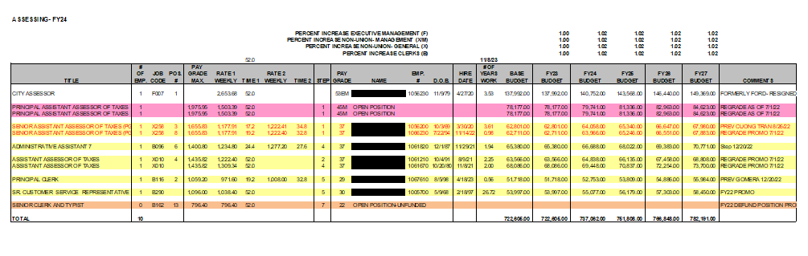
DEPARTMENT OPERATING BUDGETS
Position Budgeting – “Salary by Name”

Slide 9
DEPARTMENT OPERATING BUDGETS
Departmental Budget Requests
  The Budget Office creates request forms in Excel and sends them to all departments for completion
  Upon receipt of the completed forms, the Budget Office reviews departmental requests and calculates the overall costs of these requests for the City Manager’s review
    Personnel Requests:
      New positions, regrades, overtime adjustments
    Operating Requests:
      New programs, changes to existing programs/services
    Changes in Other Funding Sources:
      Grant funding for personnel and programs

Slide 10
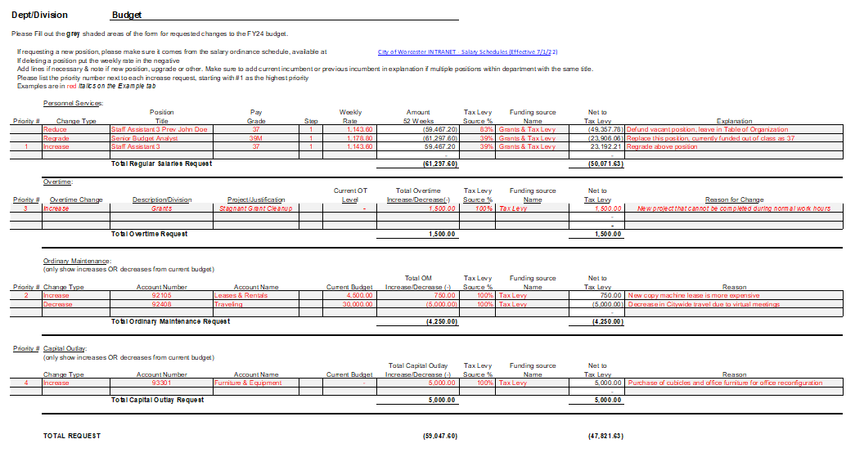
DEPARTMENT OPERATING BUDGETS

Slide 11
OPERATING BUDGET DECISION PROCESS
Departments meet with the City Manager, CFO, and Budget Director to review budget requests and performance measures
Budget decisions are made in the context of the City Manager’s priorities, overall funding availability, and impact on future operations
The Budget Office calculates decision scenarios in Excel templates and updates departmental budgets based on approved requests
  The operating budget is created and managed in Excel
  Master files are created in Excel and are used to ensure the budget stays in balance

Slide 12
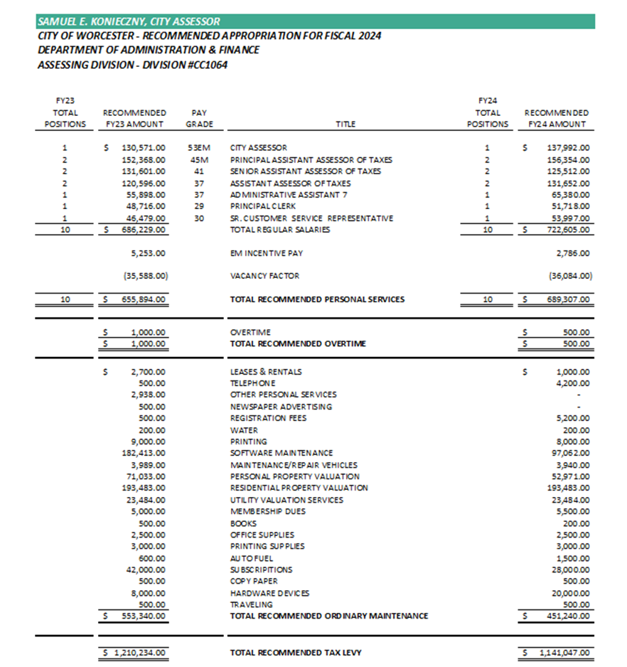
OPERATING BUDGET FINALIZATION
Department budgets are finalized
  Department Overview, Performance Measures, Table of Organization, Historical Budget Data, and Line Item Budget
Once department budgets are finalized, the following sections are completed:
  Financial Summary of Revenues & Expenditures
  Citywide Organizational Chart
  Citywide Line Item Budget
  Citywide Strategic Plan and Performance Measures

Slide 13
OPERATING BUDGET FINALIZATION
The full budget document is compiled by the Budget Office
  Software: Microsoft Office products (Word, Excel, PowerPoint) and Adobe
Budget hearings with City Council are held over approximately 5 weeks, one evening per week
  The City Manager presents the overall budget and then each department has a hearing with City Council
Once approved by City Council, the Budget Office uploads an Enterprise Interface Builder (EIB) of the operating budget into the City’s ERP system, Workday
  The EIB is loaded prior to the start of the new fiscal year so that it is operational as of July 1st

Slide 14
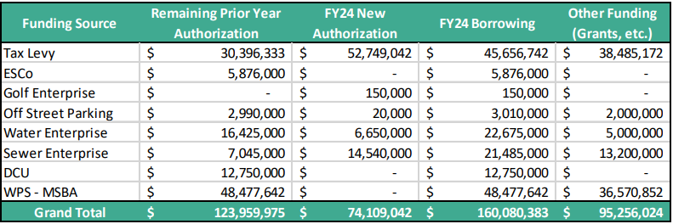
FY2024 CAPITAL BORROWING $160M

Slide 15
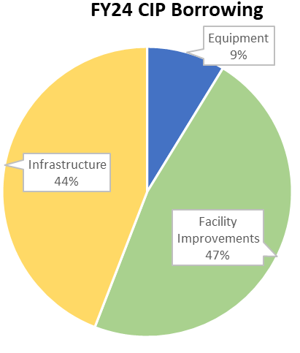
CAPITAL
The capital budget process runs concurrently with the operating budget schedule and is produced as a five year capital improvement plan (CIP)
There are two sub-budgets of the capital budget:
Annual Borrowing
  Amount authorized to borrow within the upcoming fiscal year from loan authorizations
  The annual borrowing budget is closely monitored in comparison to the City’s debt policy
New Loan Authorizations
  New projects or existing projects that required additional funding
The City uses three capital categories:
Equipment
Facility Improvements
Infrastructure

Slide 16
CAPITAL
Capital Budget Process:
The Budget Office sends Excel request forms to departments
  Section for ongoing projects that require future borrowing
    Source data is ERP system (contracts/PO’s)
  Section for new projects to be requested by departments
    Departments provide the overall project cost and 5 year estimated cash flow
    Combination of new and exiting loan authorizations can be used to fully fund a project
Capital requests are reviewed during operating budget meetings with the City Manager and departments
Decisions on existing and new project funding are made in the context of funding availability
As decisions are made, the Budget Office creates the CIP and associated loan orders
  The capital budget is completed in Excel and incorporated into a Word document for final distribution
  Loan orders are created in Word and reviewed by Bond Counsel prior to being submitted to City Council for approval

Slide 17

CURRENT BUDGET TOOLS
  Tools for Successful Budget Development & Management
  Microsoft Office (Excel, Word, and PowerPoint)
    Staff with advanced skills (i.e. pivot tables, vlookup, complex formulas, linking of various files, etc.)
  Access to Data
    Templates, projections, financial systems, etc.
  Staff & Public Engagement
    Departments, Administration, and Elected Officials
  Time
    Comprehensive analysis, reconciliations, reviews, discussions, and compilation
  Teamwork
    Supporting analysts, providing guidance and feedback, and taking on tasks when necessary

Slide 18


CURRENT BUDGET TOOLS – PROS & CONS
  Pros:
  Details
    Access to detailed historical data
    Transparency of operations
    Low cost
  Familiarity
    Microsoft Office (Excel and Word) are widely understood and relatively easy to use
    Existing templates have been used for 10+ years and are well understood by existing staff
  Cons:
  Human Error
    Manual process to update departmental files
    File links and formulas can easily be unintentionally broken
  Inefficiencies
    Updating many individual files
    Lacking new technology to standardize files and processes

Slide 19
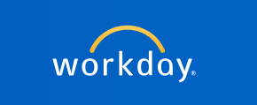
FUTURE BUDGET TOOLS
  Implementation of new ERP system, Workday:
  Financials - March 2023
  Human Capital Management (HCM) - Implementation Phase
    Budgeted positions
    Fringe Benefit data
  Adaptive Planning – Fiscal Year 2026(?)
    Planning platform for budgeting and analysis
    Integration with ERP and HCM
    Auto-generated budgeting capabilities

